Slide 1
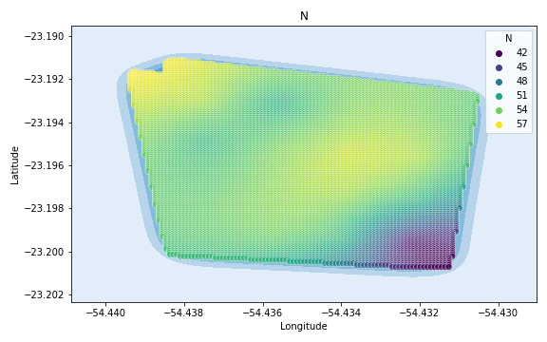
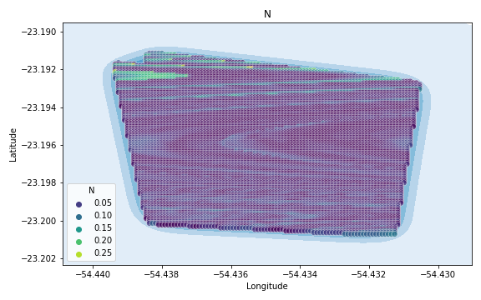
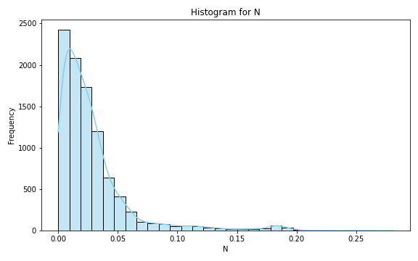
Analysis for column: N Model: Linear Regression
Statistics:
mean 0.028414
std 0.032345
min 0.000011
25% 0.009129
50% 0.019913
75% 0.034011
80% 0.038665
85% 0.046242
90% 0.056573
95% 0.091107
99% 0.182177

Slide 2
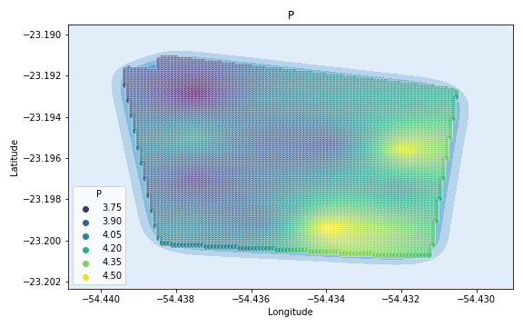
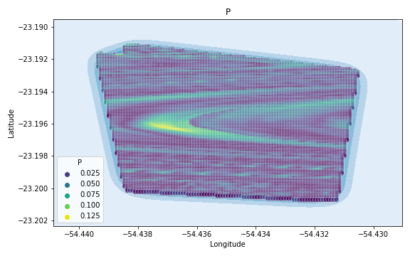
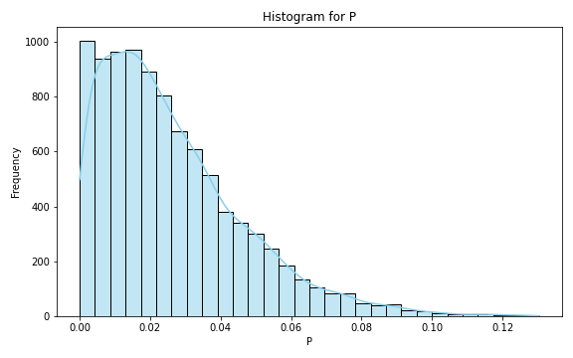
Analysis for column: P Model: Linear Regression
Statistics:
mean 0.026156
std 0.020525
min 0.000005
25% 0.010577
50% 0.021567
75% 0.036656
80% 0.041416
85% 0.047104
90% 0.054210
95% 0.066276
99% 0.091061

Slide 3
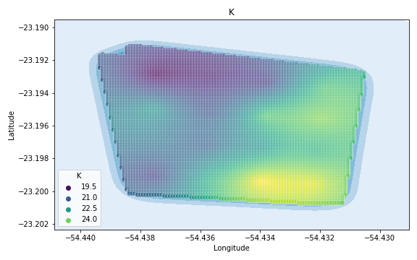
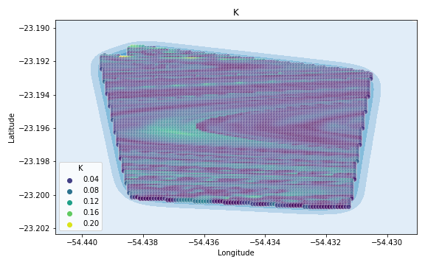
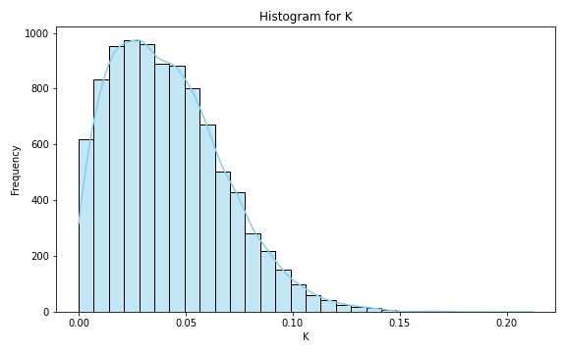
Analysis for column: K Model: Linear Regression
Statistics:
mean 0.041857
std 0.026696
min 0.000004
25% 0.020977
50% 0.038524
75% 0.058262
80% 0.063350
85% 0.069869
90% 0.077500
95% 0.090262
99% 0.117098

Slide 4
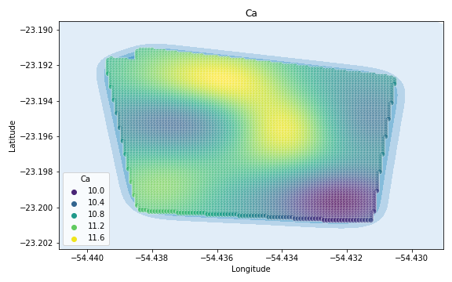
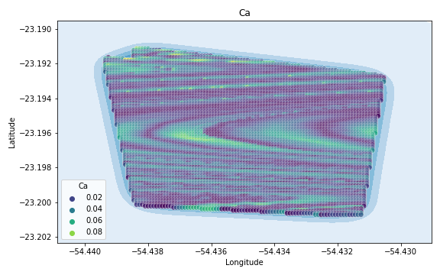
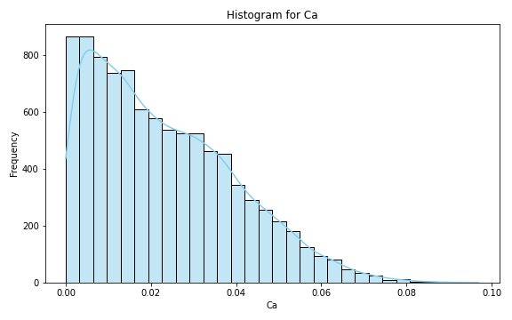
Analysis for column: Ca Model: Linear Regression
Statistics:
mean 0.023070
std 0.016855
min 0.000004
25% 0.008990
50% 0.019976
75% 0.034378
80% 0.037853
85% 0.041840
90% 0.047089
95% 0.054488
99% 0.068023

Slide 5
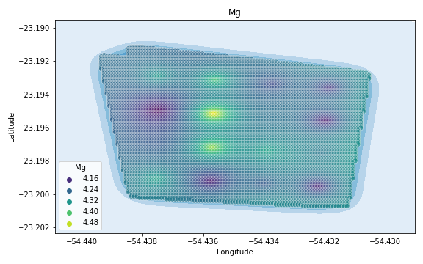
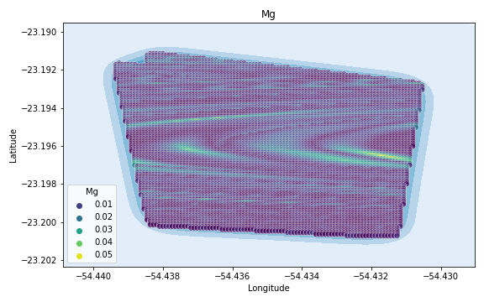
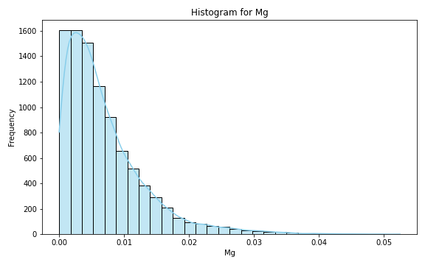
Analysis for column: Mg Model: Linear Regression
Statistics:
mean 6.952835e-03
std 6.221603e-03
min 2.959920e-07
25% 2.575019e-03
50% 5.257627e-03
75% 9.425402e-03
80% 1.083091e-02
85% 1.251788e-02
90% 1.479024e-02
95% 1.915826e-02
99% 2.980248e-02

Slide 6
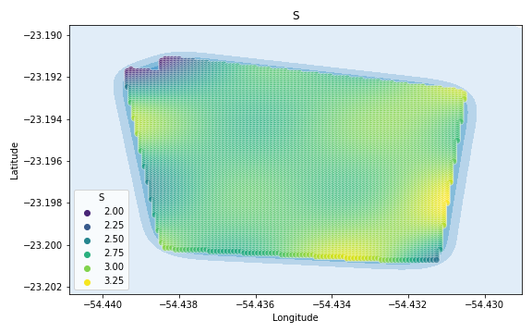
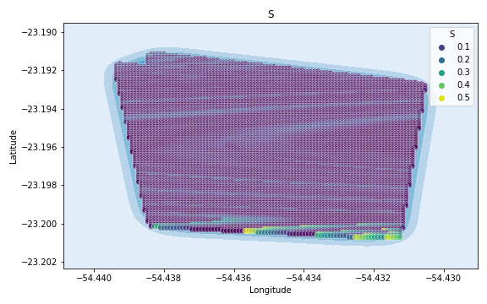
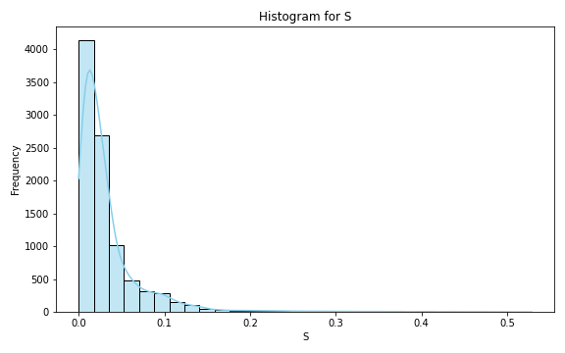
Analysis for column: S Model: Linear Regression
Statistics:
mean 0.034647
std 0.047878
min 0.000003
25% 0.010302
50% 0.020818
75% 0.037917
80% 0.046106
85% 0.059176
90% 0.079660
95% 0.110921
99% 0.260136

Slide 7
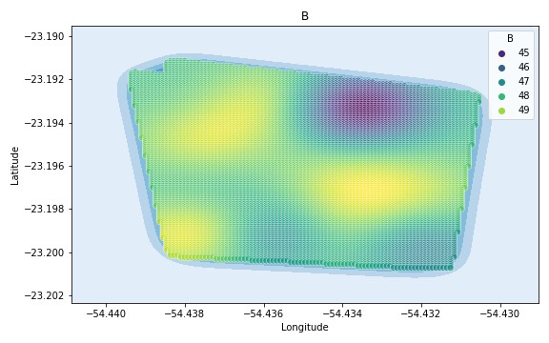
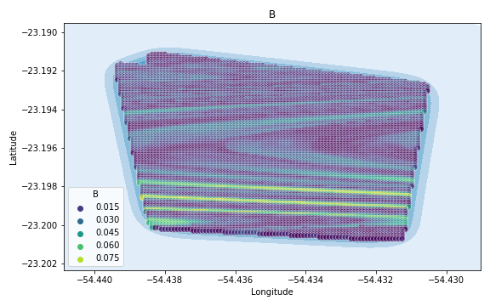
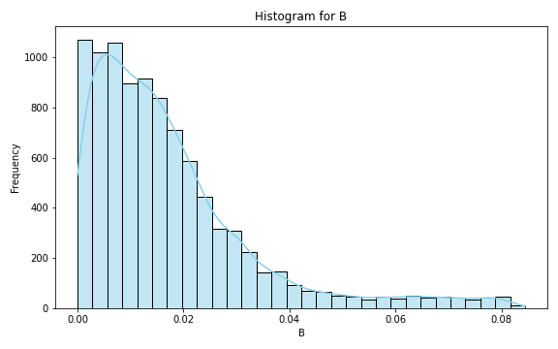
Analysis for column: B Model: Linear Regression
Statistics:
mean 0.017292
std 0.015754
min 0.000001
25% 0.006353
50% 0.013391
75% 0.022542
80% 0.025552
85% 0.029848
90% 0.036154
95% 0.052015
99% 0.076633

Slide 8
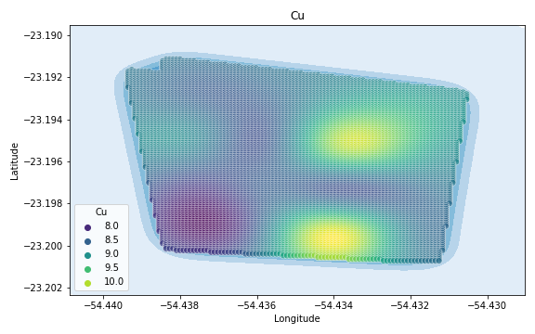
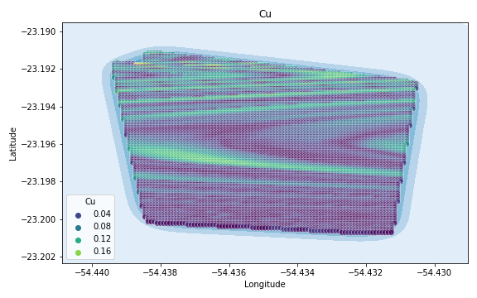
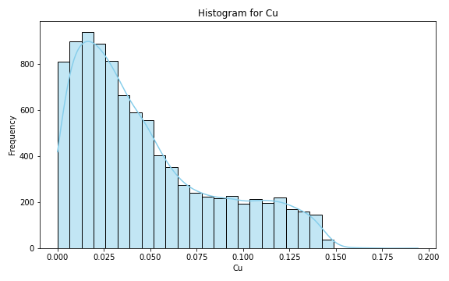
Analysis for column: Cu Model: Linear Regression
Statistics:
mean 4.720279e-02
std 3.776169e-02
min 5.409407e-07
25% 1.742270e-02
50% 3.603523e-02
75% 6.885223e-02
80% 8.126106e-02
85% 9.523466e-02
90% 1.099881e-01
95% 1.250578e-01
99% 1.397166e-01

Slide 9
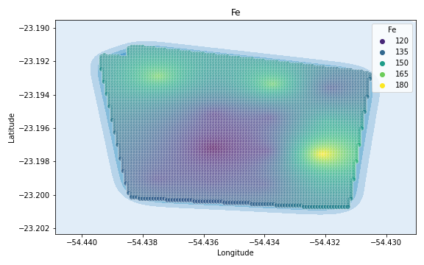
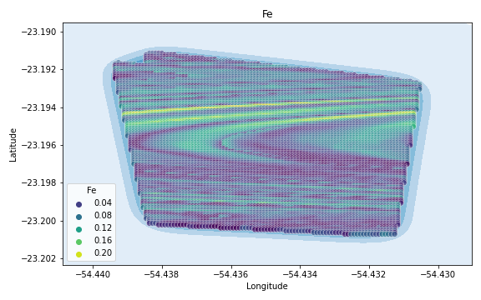
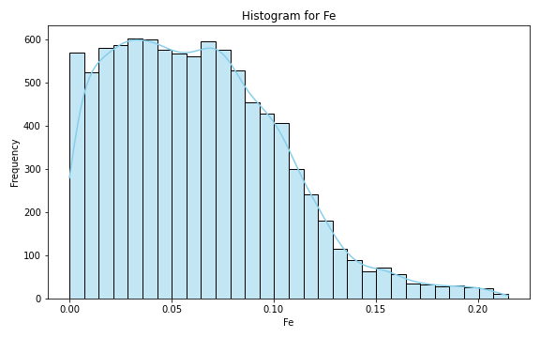
Analysis for column: Fe Model: Linear Regression
Statistics:
mean 0.062909
std 0.041216
min 0.000005
25% 0.029749
50% 0.058780
75% 0.089548
80% 0.096996
85% 0.105275
90% 0.116444
95% 0.135908
99% 0.185688

Slide 10
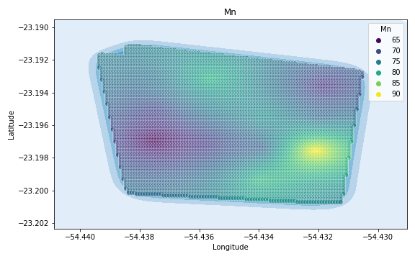
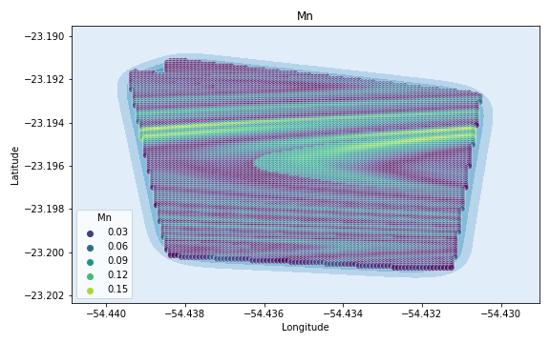
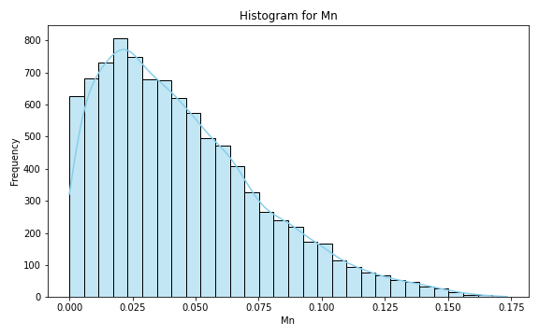
Analysis for column: Mn Model: Linear Regression
Statistics:
mean 4.470646e-02
std 3.205055e-02
min 4.567402e-07
25% 1.979356e-02
50% 3.833379e-02
75% 6.307776e-02
80% 6.982839e-02
85% 7.911601e-02
90% 9.037822e-02
95% 1.074765e-01
99% 1.381079e-01

Slide 11
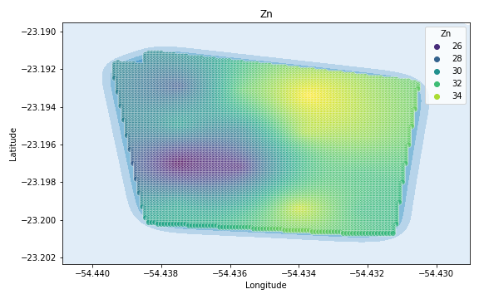
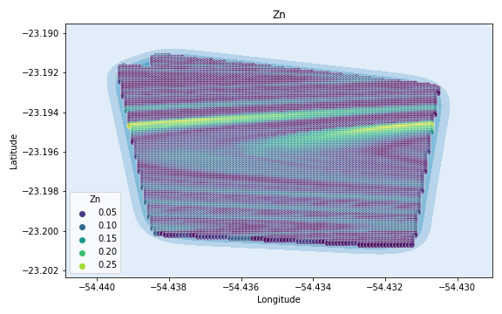
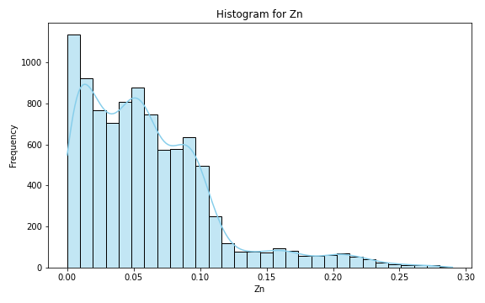
Analysis for column: Zn Model: Linear Regression
Statistics:
mean 0.061575
std 0.050239
min 0.000004
25% 0.022850
50% 0.052634
75% 0.086701
80% 0.093631
85% 0.101439
90% 0.116782
95% 0.168909
99% 0.230561

Slide 12
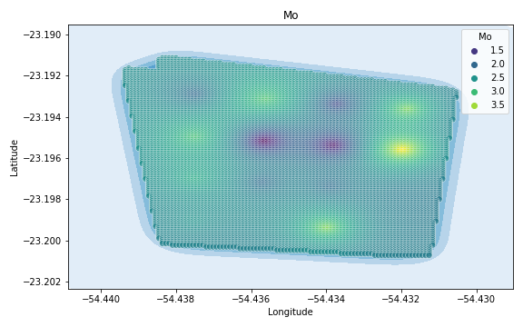
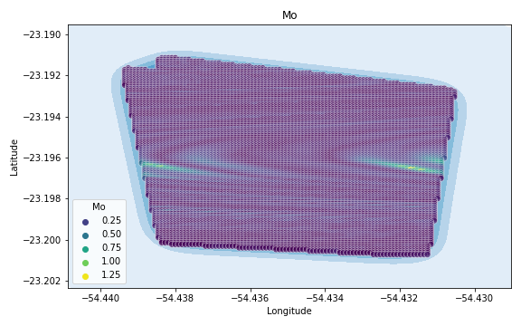
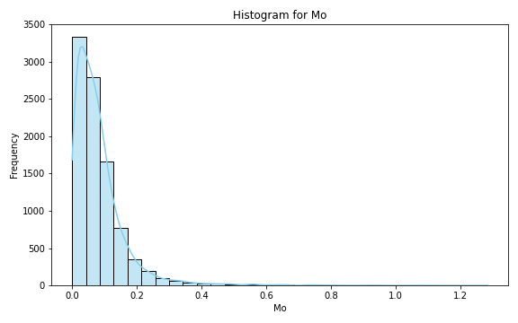
Analysis for column: Mo Model: Linear Regression
Statistics:
mean 0.083688
std 0.090074
min 0.000015
25% 0.029684
50% 0.062892
75% 0.106297
80% 0.120032
85% 0.138752
90% 0.167125
95% 0.225264
99% 0.464730

Slide 13
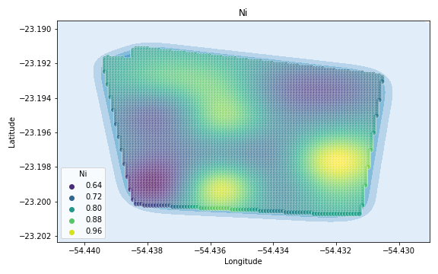
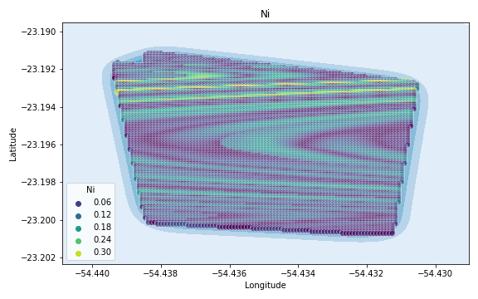
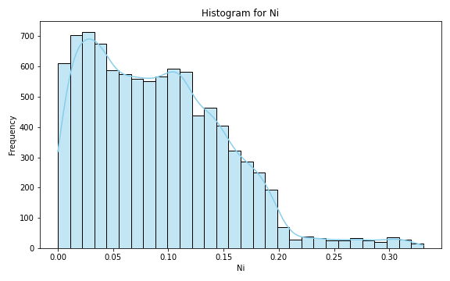
Analysis for column: Ni Model: Linear Regression
Statistics:
mean 0.090246
std 0.062366
min 0.000006
25% 0.038609
50% 0.083327
75% 0.130369
80% 0.142134
85% 0.154978
90% 0.172069
95% 0.192826
99% 0.290843

Slide 14
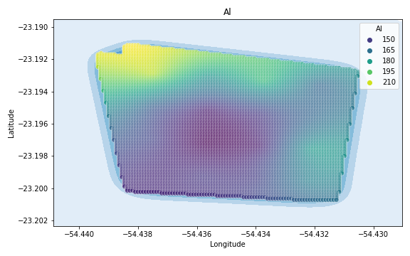
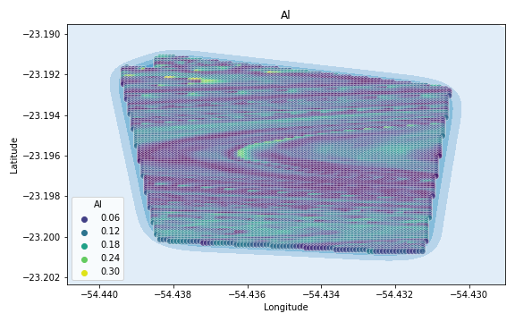
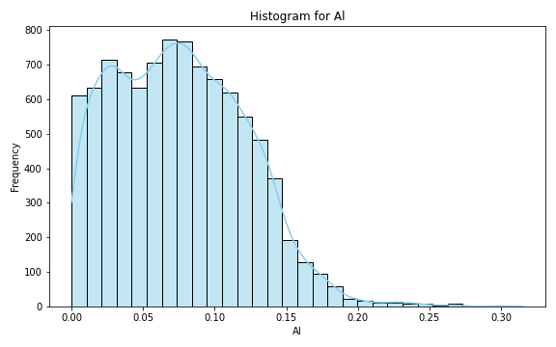
Analysis for column: Al Model: Linear Regression
Statistics:
mean 0.075967
std 0.046268
min 0.000014
25% 0.037962
50% 0.073414
75% 0.109100
80% 0.117153
85% 0.126388
90% 0.136626
95% 0.152165
99% 0.190205

Slide 15
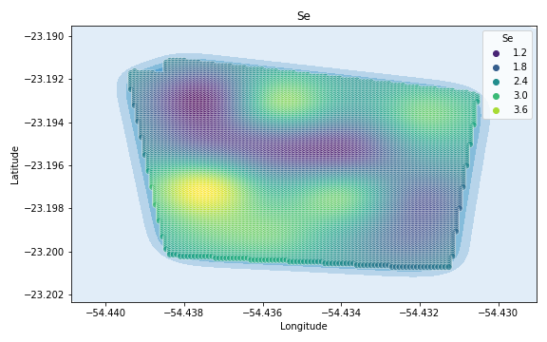
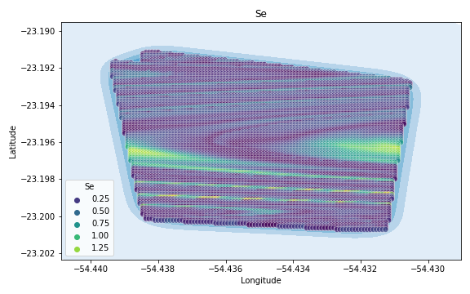
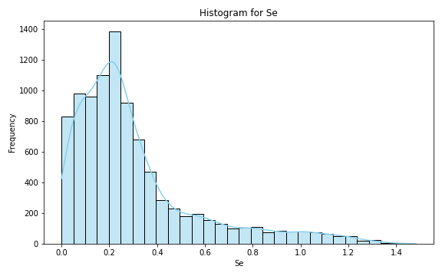
Analysis for column: Se Model: Linear Regression
Statistics:
mean 0.303496
std 0.266070
min 0.000082
25% 0.129265
50% 0.228408
75% 0.367272
80% 0.434963
85% 0.546147
90% 0.690786
95% 0.930709
99% 1.199839

Slide 16
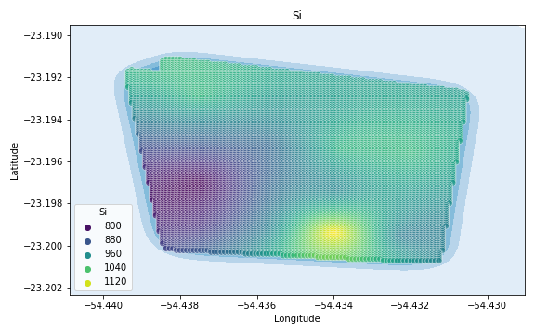
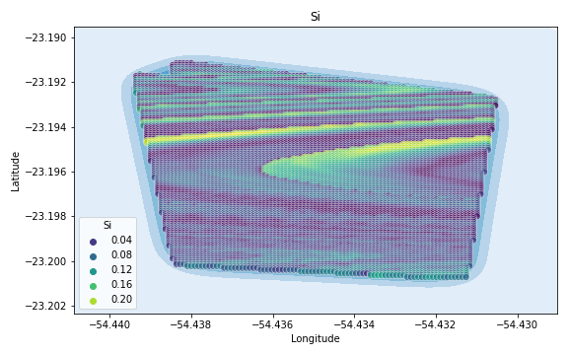
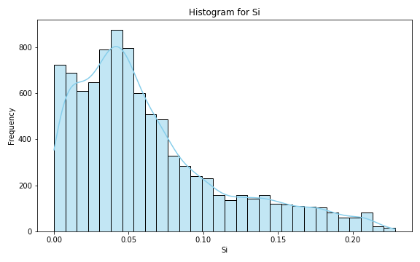
Analysis for column: Si Model: Linear Regression
Statistics:
mean 0.062847
std 0.049831
min 0.000022
25% 0.026875
50% 0.049230
75% 0.084583
80% 0.098148
85% 0.117971
90% 0.142114
95% 0.172778
99% 0.208261

Slide 17
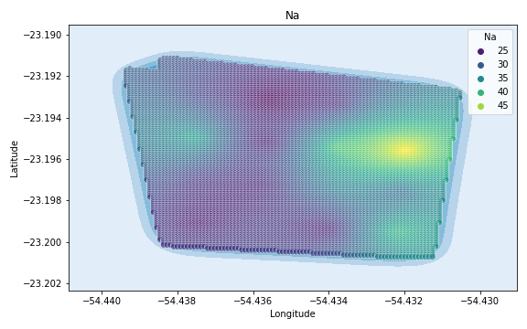
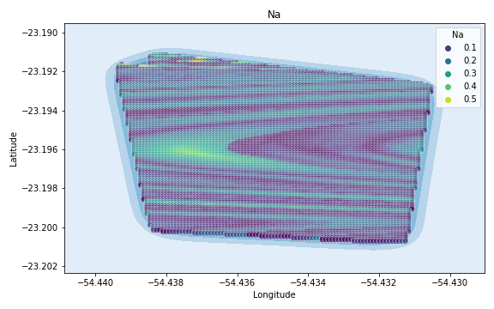

Analysis for column: Na Model: Linear Regression
Statistics:
mean 0.132873
std 0.088472
min 0.000019
25% 0.058000
50% 0.121499
75% 0.198260
80% 0.211510
85% 0.228094
90% 0.246663
95% 0.286275
99% 0.369575

Slide 18



Analysis for column: Va Model: Linear Regression
Statistics:
mean 0.090190
std 0.073121
min 0.000009
25% 0.035566
50% 0.072115
75% 0.123752
80% 0.142993
85% 0.168671
90% 0.201238
95% 0.242752
99% 0.321343

Slide 19



Analysis for column: DRIS_N Model: Linear Regression
Statistics:
mean 0.291516
std 0.220234
min 0.000120
25% 0.120372
50% 0.252811
75% 0.409755
80% 0.447479
85% 0.493244
90% 0.569656
95% 0.745012
99% 0.970993

Slide 20



Analysis for column: DRIS_P Model: Linear Regression
Statistics:
mean 0.327043
std 6.619921
min 0.000003
25% 0.063644
50% 0.134122
75% 0.226715
80% 0.260865
85% 0.307566
90% 0.374951
95% 0.567360
99% 2.091020

Slide 21



Analysis for column: DRIS_K Model: Linear Regression
Statistics:
mean 2.624271
std 85.443216
min 0.000092
25% 0.169368
50% 0.368469
75% 0.852931
80% 1.319446
85% 1.718349
90% 2.385693
95% 3.929588
99% 20.244147

Slide 22



Analysis for column: DRIS_Ca Model: Linear Regression
Statistics:
mean 2.170729
std 34.466473
min 0.000125
25% 0.112856
50% 0.232319
75% 0.501914
80% 0.749974
85% 1.462515
90% 2.372088
95% 5.482829
99% 23.673776

Slide 23



Analysis for column: DRIS_Mg Model: Linear Regression
Statistics:
mean 0.145000
std 0.129773
min 0.000025
25% 0.055457
50% 0.113799
75% 0.193114
80% 0.214358
85% 0.240600
90% 0.291859
95% 0.419633
99% 0.652642

Slide 24



Analysis for column: DRIS_S Model: Linear Regression
Statistics:
mean 3.337222
std 63.864313
min 0.000038
25% 0.459499
50% 0.768269
75% 1.281654
80% 1.539222
85% 1.882288
90% 2.602100
95% 4.737016
99% 21.950226

Slide 25



Analysis for column: DRIS_B Model: Linear Regression
Statistics:
mean 0.316973
std 0.413790
min 0.000002
25% 0.093289
50% 0.190769
75% 0.318762
80% 0.382425
85% 0.531961
90% 0.769661
95% 1.237241
99% 2.195713

Slide 26



Analysis for column: DRIS_Cu Model: Linear Regression
Statistics:
mean 0.072579
std 0.064789
min 0.000018
25% 0.021378
50% 0.050488
75% 0.113537
80% 0.127288
85% 0.141016
90% 0.161228
95% 0.206883
99% 0.274433

Slide 27



Analysis for column: DRIS_Fe Model: Linear Regression
Statistics:
mean 0.237722
std 0.187309
min 0.000053
25% 0.090341
50% 0.200653
75% 0.329741
80% 0.369367
85% 0.422942
90% 0.493661
95% 0.624441
99% 0.837958

Slide 28



Analysis for column: DRIS_Mn Model: Linear Regression
Statistics:
mean 0.281238
std 0.262275
min 0.000002
25% 0.083443
50% 0.216482
75% 0.371655
80% 0.435909
85% 0.500168
90% 0.667736
95% 0.884152
99% 1.136642

Slide 29



Analysis for column: DRIS_Zn Model: Linear Regression
Statistics:
mean 0.265495
std 0.203167
min 0.000047
25% 0.108697
50% 0.209296
75% 0.384746
80% 0.430798
85% 0.494170
90% 0.585655
95% 0.682104
99% 0.826012

Slide 30



Analysis for column: IMS Model: Linear Regression
Statistics:
mean 0.266255
std 0.257566
min 0.000184
25% 0.074063
50% 0.187417
75% 0.359868
80% 0.412472
85% 0.509796
90% 0.665145
95% 0.837679
99% 1.124736

Slide 31



Analysis for column: IBN Model: Linear Regression
Statistics:
mean 0.080100
std 0.061357
min 0.000009
25% 0.029685
50% 0.066485
75% 0.117677
80% 0.133582
85% 0.152170
90% 0.172240
95% 0.197384
99% 0.249174

